Slide 1



SQLucid: Grounding Natural Language Database Queries with Interactive Explanations
Yuan Tian Purdue University
Jonathan K. Kummerfeld The University of Sydney
Toby Jia-Jun Li University of Notre Dame
Tianyi Zhang Purdue University
Notes:
Hello everyone,
My name is Yuan Tian. I’m currently a PhD student from Purdue university.
I’m glad to introduce our work on behalf of my collaborators, SQLucid: Grounding natural language database queries with interactive explanations
This work is in collaboration with Professor Jonathan Kummerfeld, Professor Toby Jia-Jun Li, Professor Tianyi Zhang

Slide 2




There is a Growing Demand for Querying Databases
SQL Query
User
Databases
Query result
Notes:
In this era of big data, we have numerous data saved in databases on the cloud
There is a growing demand for querying databases to access these data for decision making and data analysis
Traditionally, accessing these data requires a database expert to write a formal query language, such as SQL.

Slide 3


NL Interfaces for Databases
Text-to-SQL
Model
Non-expert
Databases
Query result
Notes:
To democratize data access, recent advances in natural language processing and machine learning enable users to query data by natural language through a text-to-SQL model. Given a database, they automatically translate a natural language question to a SQL query.

Slide 4


NL Interfaces may misinterpret user intents
Best models have error rates of at least 10% on Spider [Yu et al., 2018] and 27% on BIRD [Li et al., 2023]
Cause severe consequences in high-stakes domains
Text-to-SQL
Model
Databases
Users don’t trust the model!
Wrong result
Notes:
However, these models are not perfect.
They makes mistakes for complex queries
The current best models achieve 10% and 27% error rates on two popular text-to-SQL benmarks, Spider and BIRD respestively.
In real world, the error rate can be even higher.
Such error rate is not acceptable in practice, especially in some high-stakes domains such as finance and healthcare, which can cause severe consequences

Slide 5



Interactive SQL Generation
Explain system decision to users
Increase user trust
Help users detect errors
Incorporate user feedback
Remove ambiguity
Allow user to fix errors
MISP [Yao et al., 2019] Multiple choice questions.
DIY [Narechania et al., 2021] Small database, NL, mappings, drop-downs.
SQLVis [Miedema et al., 2021] Visualize SQL as graph.
Notes:
Interactive approaches
To address this challenges, recent works have focused on building human-in-the-loop approaches
to help users understand model decisions
and incorporate human feedback after the text-to-SQL generation. For example, …
Examples
For example, MISP, DIY, and SQLVis are three representative approaches for explaining SQL or interactive generation
MISP asks multiple choice questions to incorporate user feedback
DIY Explain SQL in a small-but-relevant database, using NL explanations, and the mapping between NL and SQL. It allows users to give feedback in a drop-down menu to select alternative values or entities.
SQLVis visually explains SQL a visual graph

Slide 6
Interactive approaches are not effective
A recent study [1] shows these approaches don’t work well.
Hard to understand the generated query and provide feedback.
 | Accuracy | SD
Manual Edit SQL | 0.55 | 0.48
MISP [Yao et al., 2019] | 0.53 | 0.51
DIY [Narechania et al., 2021] | 0.56 | 0.51
SQLVis [Miedema et al., 2021] | 0.60 | 0.50
[1] Ning, Z., Zhang, Z., Sun, T., Tian, Y., Zhang, T., & Li, T. J.-J. An empirical study of model errors and user error discovery and repair strategies in natural language database queries (IUI’23)
Notes:
Unfortunately, these approaches have different limitations.
A recent study evaluates these three representative interactive approaches and found they didn’t significantly improves end-to-end performance, compared to manually editing the SQL query
In their study, participants found it hard to understand the generated query and provide feedback

Slide 7
Limitations of Existing Interactive Approaches
MISP [Yao et al., 2019]
DIY [Narechania et al., 2021]
SQLVis [Miedema et al., 2021]
Limited Explanations
No explanations
Small database is inconsistent
Graph is overwhelming
Constrained Feedbacks
Passively answer questions
Only simple edits
No feedback
Notes:
These approaches are limited in two ways
Regarding the explanation
MISP asks clarifications in a conversation, but it doesn’t explicitly explain the SQL query. In many cases, users still need to read the SQL query.
DIY
sometimes lead to user confusion. User may find
inconsistency between query results on the sampled database with
the original full database, as some relevant data may be missing
SQLvis explains the SQL as a graph, however, when the SQL is complex, the visual graph can be unintuitive and overwhelming

Slide 8

Grounding Theory in Communication
Mutual Understanding
Common ground
Shared knowledge
Ensure messages interpreted correctly
Human
Human
Common Ground
Grounding in Communication [Clark et al. 1991]
Notes:
To bridge this gap, we design an interactive SQL generation system by drawing inspiration from the grounding theory in communication
Grounding Theory is a concept from social psychology. It suggests people should ensure mutual understanding between each other in conversation, by establishing common ground.
Common ground: is the set of shared knowledge, beliefs, and assumptions that people have about each other the discussing topic in the conversation. For communication to be effective, people must have some degree of common ground, which helps them interpret each other’s messages correctly. Without common ground, communication may lead to misinterpretations.

Slide 9
SQLucid: Grounding Natural Language Database Queries with Interactive Explanations
Three Key features
Editable
Step-by-step Explanation
Visual Correspondence
Intermediate Query Results
1
2
3
inspired by Grounding Theory
Notes:
To bridge this gap, we propose SQLucid, an interactive text-to-SQL generation approach, inspired by grounding theory
It has three key features

Slide 10


Interactive Explanation as Common Ground
What's the lowest flight price?
In table flight
Sort records based on price, get the minimum price
Return the price
Agent
Human
Common Ground
Human and the agent collaboratively refine the query
Notes:
Inspired by the grounding theory, SQLucid builds the common ground in the form of an editable step-by-step explanations of the generated SQL
This explanation is enriched and interactive,
It serves as a shared knowledge between the user and the agent
End-users who are not familiar with SQL can easily understand it
Through this interactive explanation, human users and system can collaboratively and iteratively refine the query

Slide 11
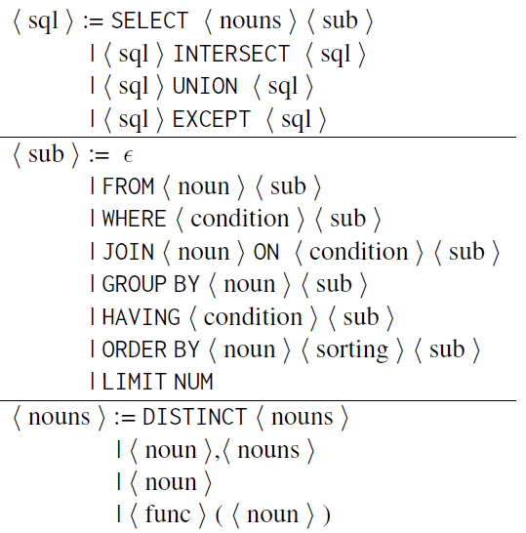
Step-by-step Explanation Generation Rules
SQL Element | Translation
SELECT | Retrun
FROM | In table
JOIN | And table
* | all records
T.col | {col} of {T}
= | is
!= | is not
> | greater than
LIKE | in form of
… | …
Notes:
We leverage a grammar-based approach to deterministically generate the step-by-step explanations in NL
Here we shows partial rules
The idea is to parse the SQL query into component by grammar,
Then we translate SQL components into NL components using a list of translation rules and rearrange them as the step-by-step explanation

Slide 12

Visual Correspondence via Highlighting
price
300
200
500
In table flight
Sort records based on price, get the minimum price
Return the price
Agent
Human
Common Ground
Notes:
Reading a step-by-step explanation can still be overwhelming for complex queries
To further facilitate the readability of our explanation, SQLucid enriches the explanation with visual correspondence
SQLucid detects the entity names or values in the explanation by the grammar, rendering them in blue colors and make them interactive.
When users hover the mouse over these colored text in the explanation, the related data, colum, or table will automatically pop up and highlighted simultaneously
This helps users to mentally relate the textual explanation to concrete data
By this feature, users can easily navigate related data by only hovering over these blue texts

Slide 13
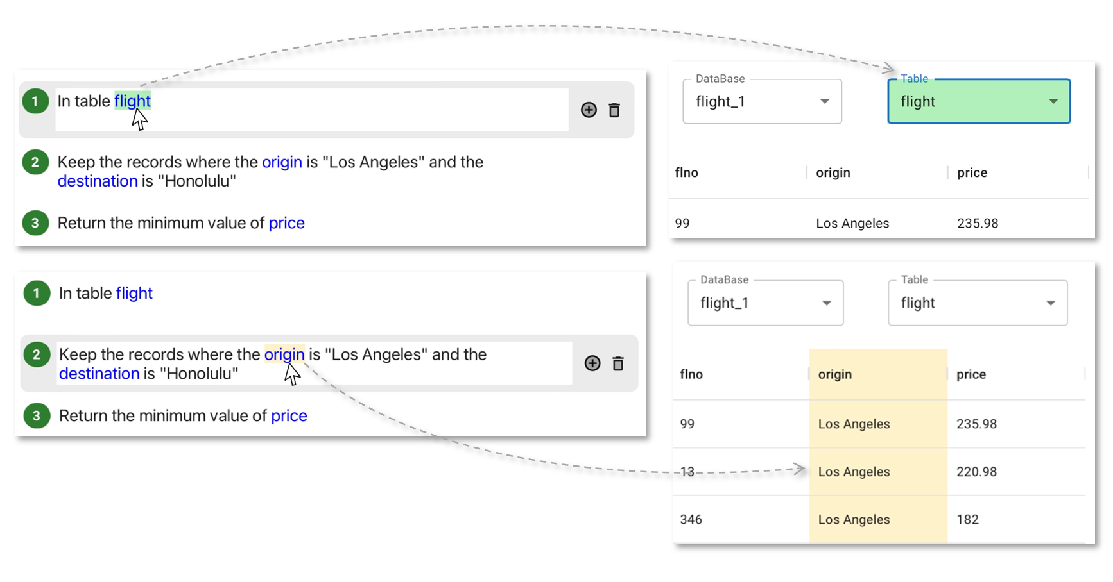
Visual Correspondence via Highlighting (UI)
Notes:
Here is our UI as an example

Slide 14

Intermediate Query Results
ID | price
2 | 200
1 | 300
3 | 500
In table flight
Sort records based on price, get the minimum price
Return the price
Agent
Human
Common Ground
Notes:
To further facilitate user understanding on the explanation, SQLucid introduces the calculation of intermediate query results, which allows users to understand the actual functionality of each step.
This features is extended and reimplemented from DIY. We calculate the results on the entire database rather than on a sampled database to ensure data consistency.
When users click a certain step, SQLucid computes an intermediate SQL query based on SQL grammar. And execute this intermediate SQL on the database to get an intermediate resulting table.

Slide 15


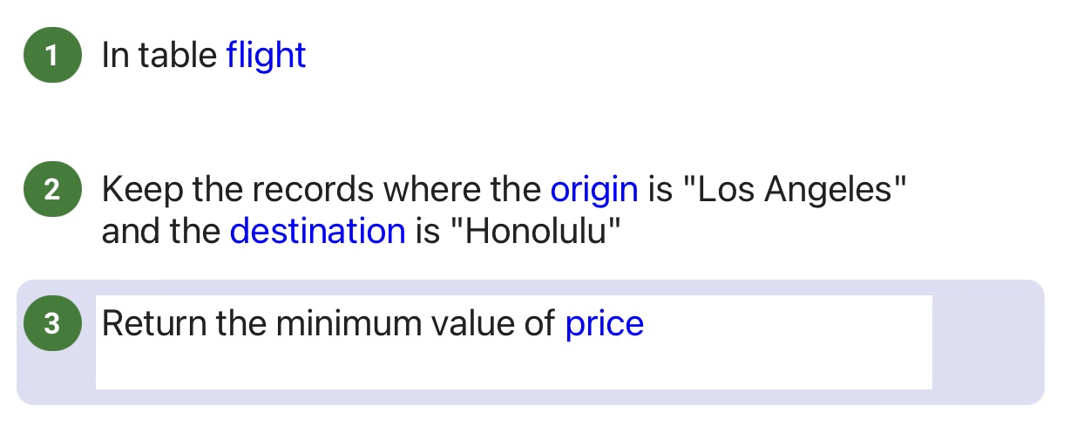

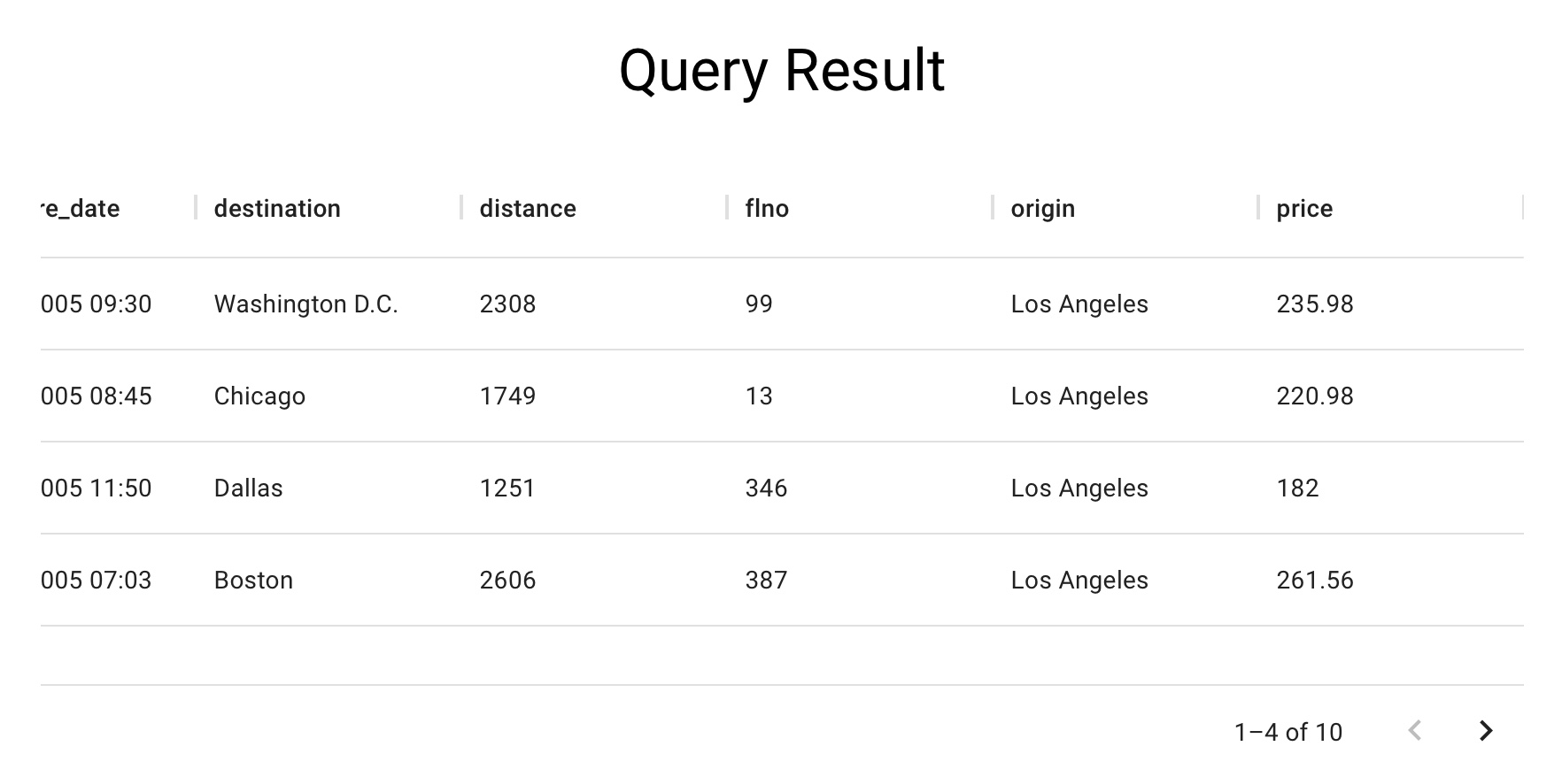
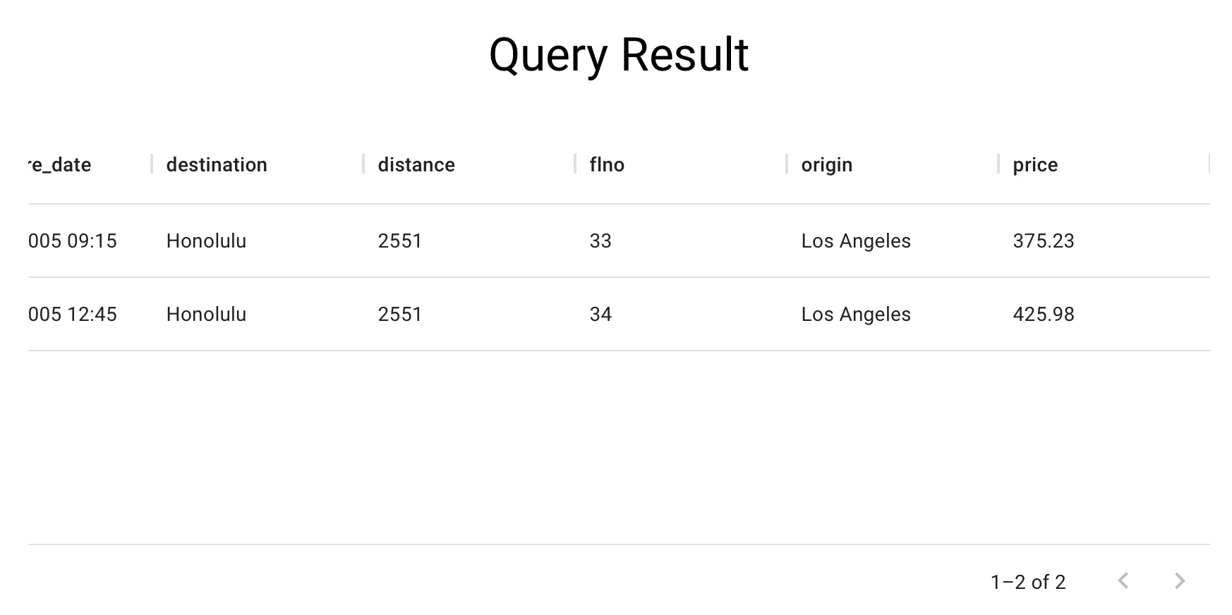

Intermediate Query Results (UI)
SELECT * FROM flight
WHERE origin = “Los Angeles”
SELECT MIN(price) FROM flight
WHERE origin = “Los Angeles”
1-4 of 100
SELECT * FROM flight
Notes:
[Intermediate Results] For intermediate query results, when a user clicks on each step, SQLucid generates a temporary intermediate SQL query and displays the results. This helps users further comprehend the query behavior by observing the actual functionality of each step.
Here is an example in our IU. There are 3 steps in total. When the user clicks on the fist step, SQLucid synthesizes this temporary query, “SELECT * FROM flight” to retrieve all the records in the flight table.
When the user clicks on the second step, SQLucid adds a where clause, filtering out the records to only keep those whose origin is los angels.

Slide 16
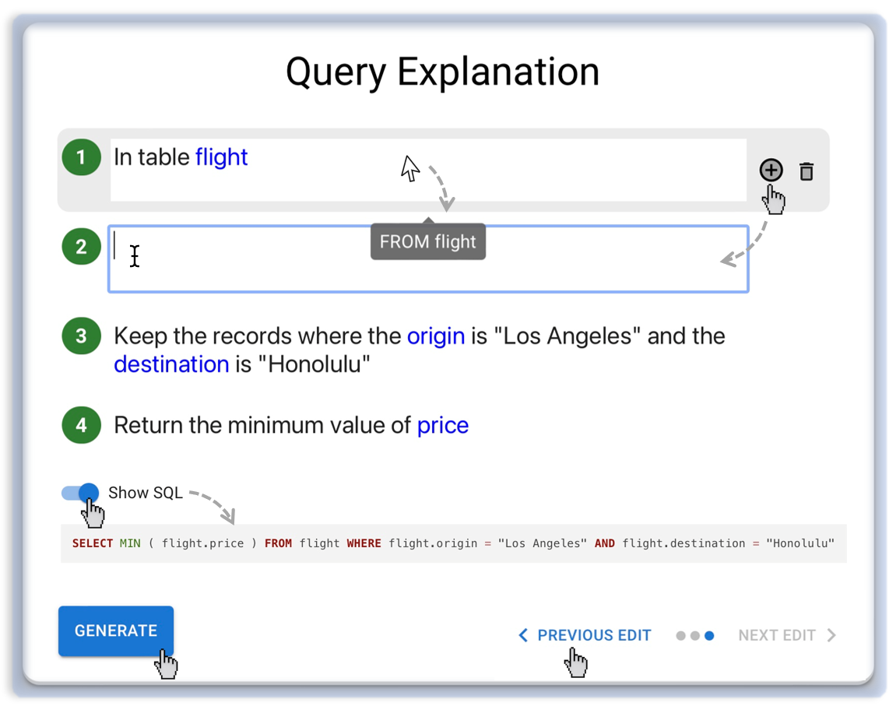
Edit Explanation to Give Feedback (UI)
Freely edit the explanation
Check edit history and undo/redo some edits
Notes:
If users detect any potential errors in the explanation, they can freely edit this explanation to give feedback.
As shown in the UI, users can add a new step or delete existing steps
Furthermore, use can edit existing steps in NL.
Based on the user edits, we fine-tuned a text-to-SQL-clause model, which takes the description of each step as input, and output a SQL component
Furthermore, to better enable users to iterate on the query, users can check edit history and undo/redo some edits
For users who understand SQL queries, they can also choose to read the SQL query as well as the corresponding components for each step

Slide 17
Text-to-clause model
Spider
Explanation generator
Modify decoding rules of a transformer-based text-to-SQL model [Rubin et al., 2021]
Finetuned on synthetic data produced by grammar-based explanation generator
90.6% exact match accuracy
Get lowest price
Synthetic data
SELECT MIN(price)
Paraphrase
Fine-tune
Transformer
Notes:
[Make the Step-by-step Explanation Editable] After users detect any potential errors, SQLucid allows users to edit this explanation freely to provide feedback. After a user edits the explanation, we use a trained text-to-clause model and a set of rules to regenerate the SQL query.
Here is our interface for explanation.
If the end-user detect any potential errors in the explanation, the user can directly and feely edit this explanation in NL
The UI allows users to add a new step or delete existing steps
After users edit the explanation, SQLucid regenerates the corresponding SQL component by heuristics (which address simple edits, such as replacing the entity name), as well as trained text-to-SQL-component model to handle complex edits.
Given a NL description of a step, the model translates the description to a SQL component.
Furthermore, to better enable users to iterate on the query, users can check edit history and undo/redo some edits
For users who understand SQL queries, they can also choose to read the SQL query as well as the corresponding components for each step

Slide 18
Evaluation
User Study 1: Compare with other interactive approaches
MISP [Yao et al., 2019] → Conversational, multiple-choice question
DIY [Narechania et al., 2021] → Sampled Database, Drop-down menu
User Study 2: Ablation study to study the effectiveness of key features
Text Explanation
Text Explanation + Visual correspondence
Text Explanation + Intermediate results
Notes:
To evaluate SQLucid's effectiveness and usability, we first compared it to two interactive SQL generation tools, MISP and DIY. MISP and DIY have different interaction mechanisms. We then conducted a second user study, ablating different features in SQLucid to investigate the effectiveness of each component.

Slide 19
User Study 1
1
15 never heard about SQL before
(End-user)
SQL generation tasks
10 minutes
MISP
[Yao et al., 2019]
10 knew SQL basics
(Novice)
2
DIY
[Narechania et al., 2021]
5 could write SQL fluent
(Expert)
Baseline
30 Participants
Tasks
Notes:
In the first user study, we recruited 30 participants with various SQL expertise

Slide 20

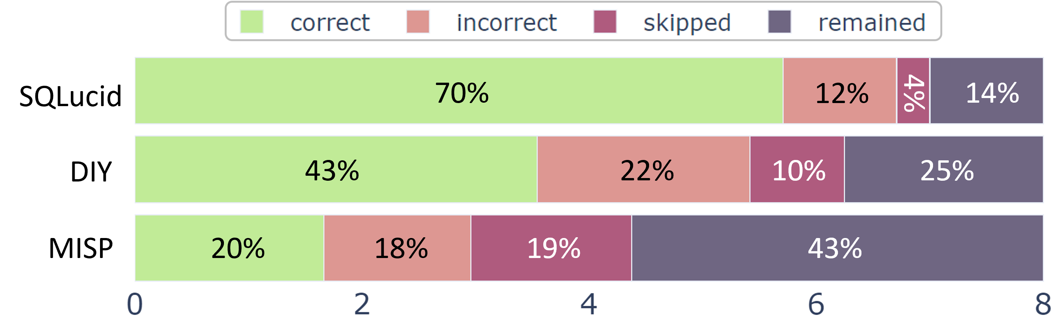
User Study 1 (Key Results)
SQLucid outperforms other tools in SQL generation performances
Notes:
SQLucids outperforms other tools
Participants using SQLucid completed more tasks correctly, with higher accuracy

Slide 21
User Study 1 (Key Results)
SQLucid consistently improves performance across different user expertise
 | End-user | Novice | Expert
MISP [Yao et al., 2019] | 1.6 | 1.4 | 2.2
DIY [Narechania et al., 2021] | 3.3 | 3.5 | 3.8
SQLucid | 5.4 | 5.7 | 5.9
Notes:
SQLucid consistently improves performance across different user expertise
It is beneficial for users who are not familiar with SQL query and users who are fluent in SQL queries

Slide 22
User Study 1 (Key Results)
SQLucid consistently improves performance across different task difficulty
 | Easy | Medium | Hard | Extra Hard
MISP [Yao et al., 2019] | 0.81 | 0.49 | 0.21 | 0.12
DIY [Narechania et al., 2021] | 1.40 | 1.19 | 0.54 | 0.35
SQLucid | 1.62 | 1.48 | 1.39 | 1.14
Notes:
SQLucids also consistently improves performance across different task difficulties
Particularly, we found its task decomposition features significantly boost accuracy for hard tasks

Slide 23
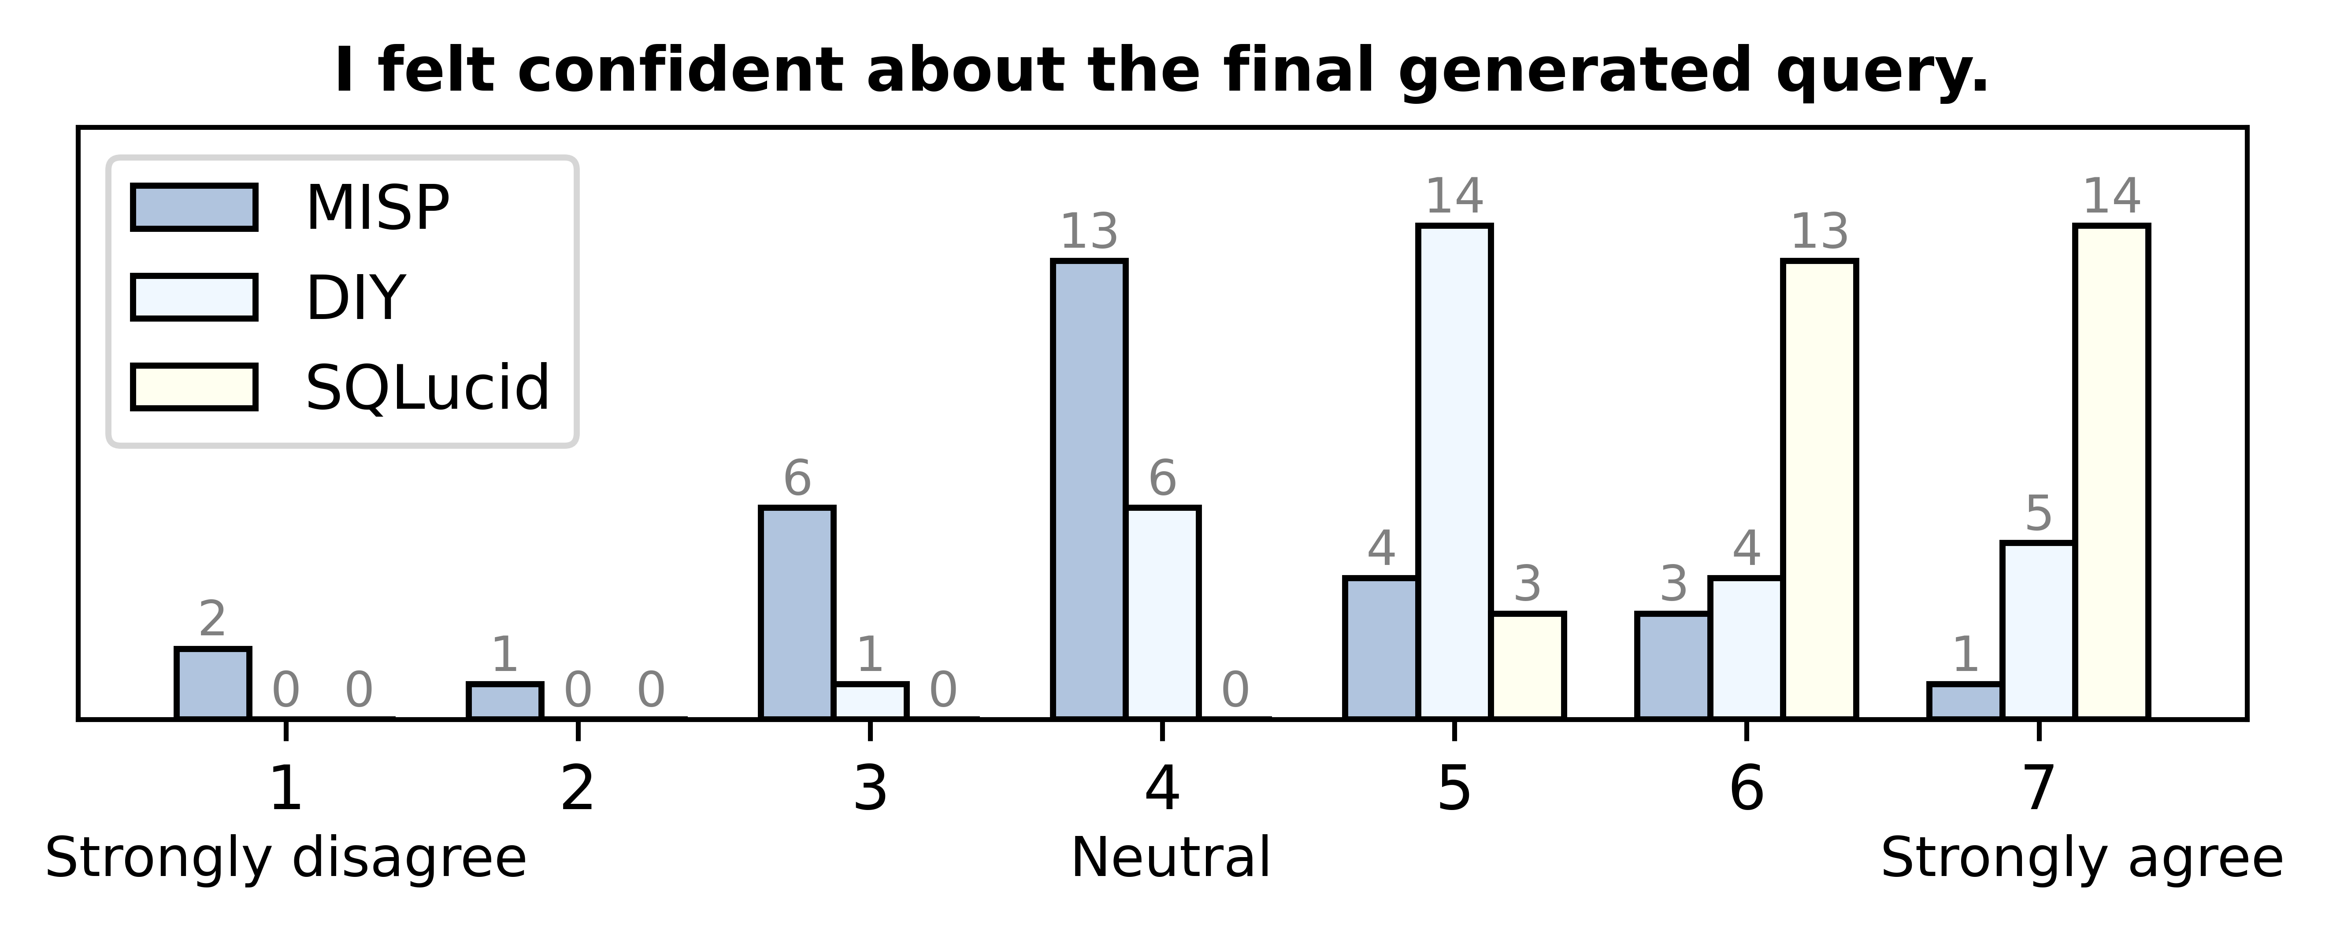
User Study 1 (Key Results)
SQLucid significantly improves user confidence
Notes:
In our final survey, participants reported SQLucid significantly improves their confidence in the generated SQL

Slide 24
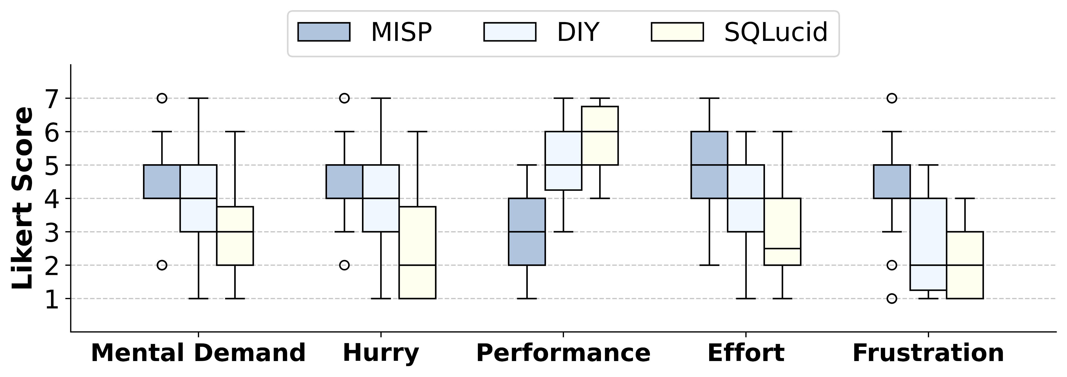
User Study 1 (Key Results)
SQLucid significantly reduces user cognitive load
Notes:
And the NASA TLX questionnaire shows SQLucid significantly reduces user cognitive load

Slide 25
User Study 2
1
- intermediate result
- visual correspondence
4 never heard about SQL before
(End-user)
SQL generation tasks
10 minutes
2
- intermediate result
+ visual correspondence
2 knew SQL basics
(Novice)
3
+ intermediate result
- visual correspondence
2 could write SQL fluent
(Expert)
Baseline
8 Participants
Tasks
Notes:
In the second user study, we aim to investigate the effectiveness of key features
We created three baselines by ablating visual correspondence and intermediate query result features
we recruited 8 participants and tasks are the same as study 1

Slide 26
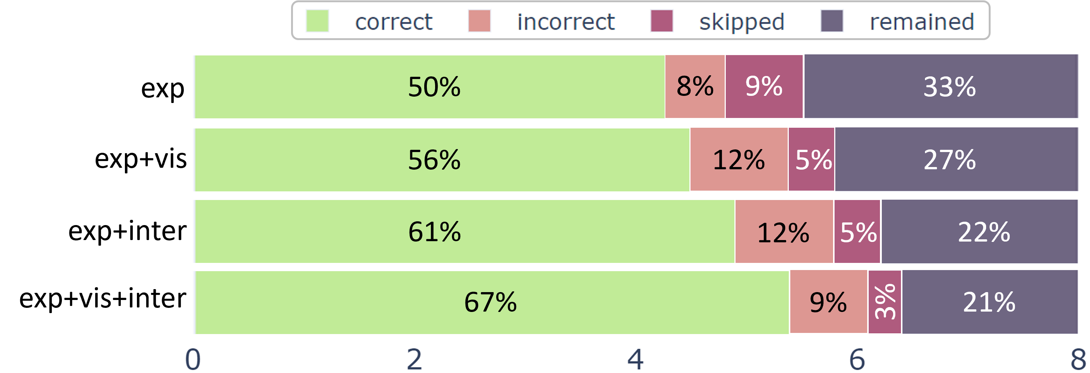
User Study 2 (Key Results)
Both features contribute to performance improvement
Notes:
The results shows both visual correspondence and intermediate query result features contribute to performance improvement

Slide 27
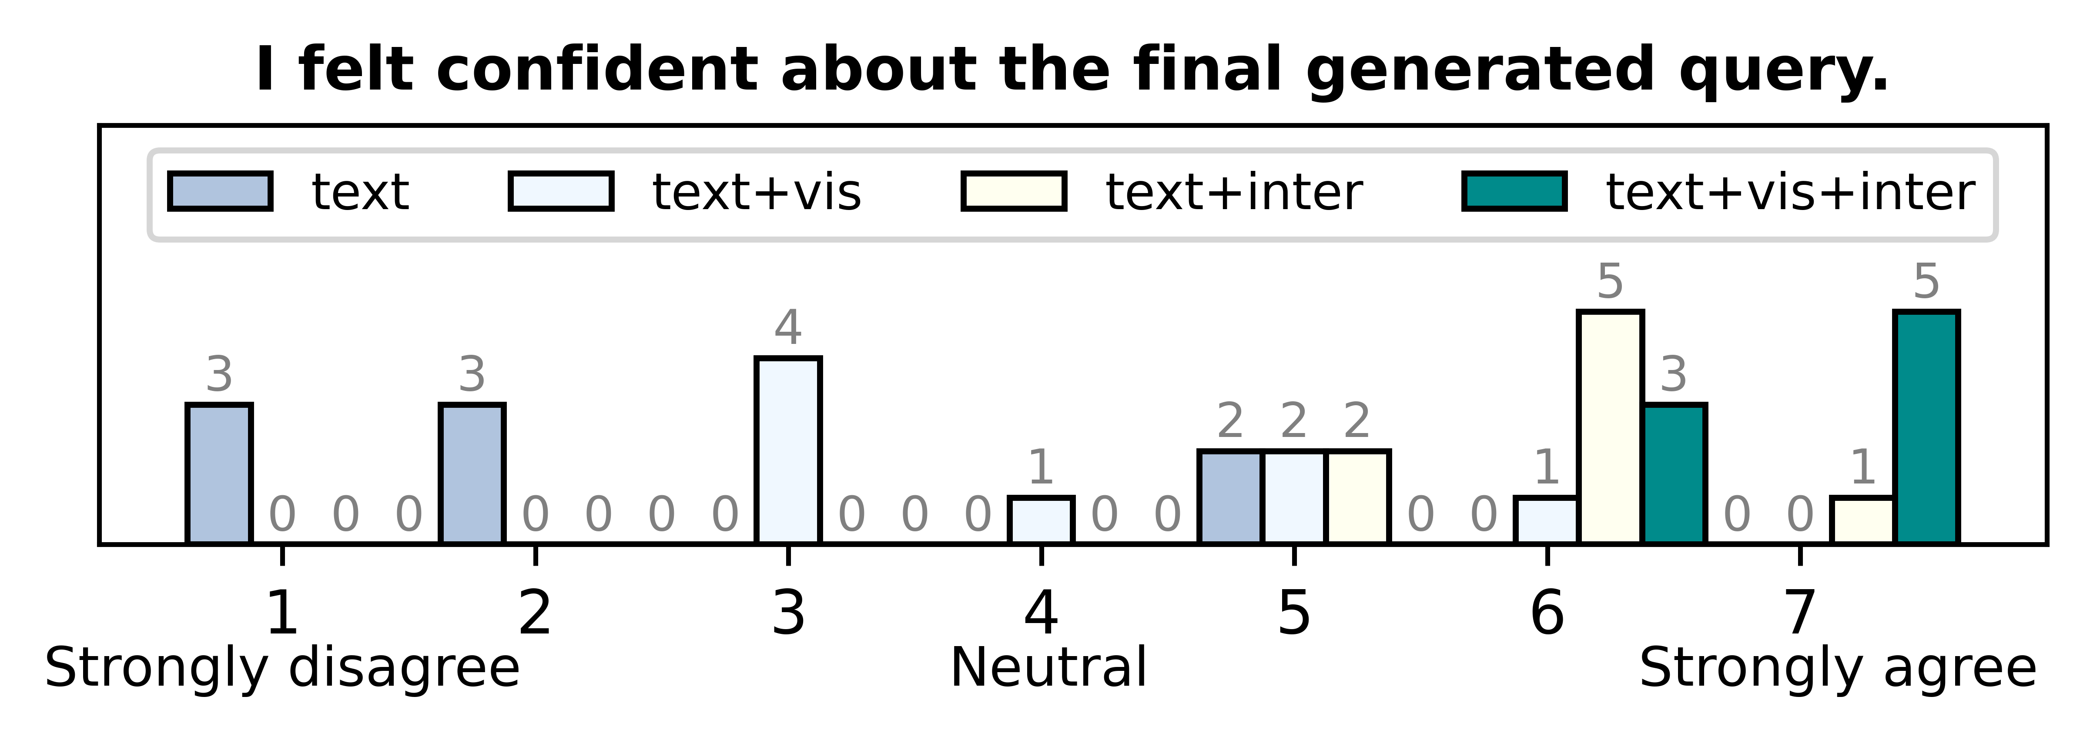
User Study 2 (Key Results)
Both features contribute to improving user confidence

Slide 28
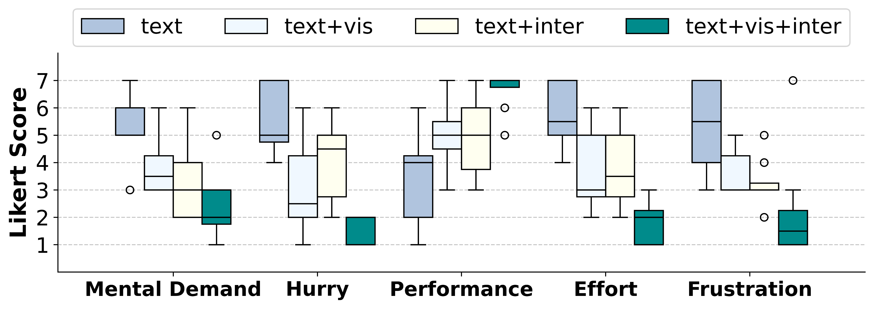
User Study 2 (Key Results)
Both features contribute to reducing user cognitive load

Slide 29
Design Implications
Establish common ground for mutual understanding.
Implement free-form feedback to improve performance.
Use task decomposition to reduce task complexity and isolate errors.
Use visual correspondence for navigation in data-intensive applications.
Notes:
Based on our findings, we list the following design implications
Establishing common ground fosters mutual understanding between humans and intelligent systems.
Free-form feedback is crucial for performance improvements.
Task decomposition enhances users' understanding of system behavior.
Step-by-step explanations help users pinpoint errors and fix them without affecting other steps.

Slide 30
Conclusion
We introduce SQLucid, an interactive database query system.
SQLucid helps users understand generated query and freely fix errors.
SQLucid significantly improves natural language query performance, with less user cognitive load and higher confidence.
Notes:
In conclusion,

Slide 31

Thank you!
Q & A
https://github.com/magic-YuanTian/SQLucid
Paper, Code, Demo
Notes:
Thanks you for listening.
Feel free to scan the QR code for more details in our paper, code, and demo

